Slide 1
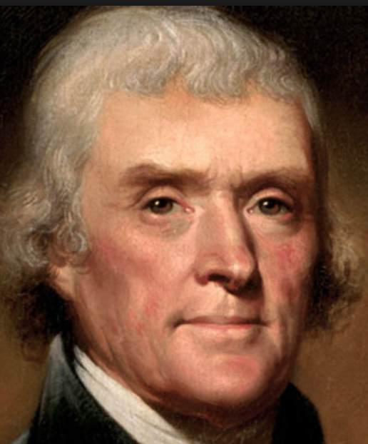
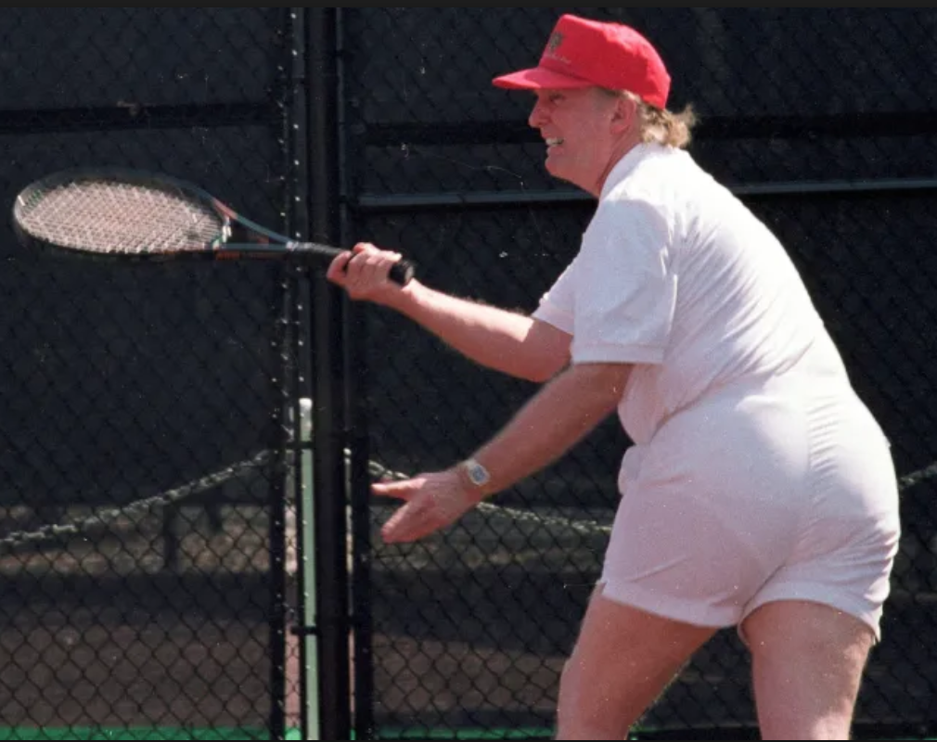
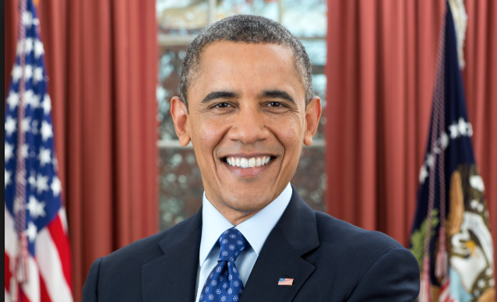
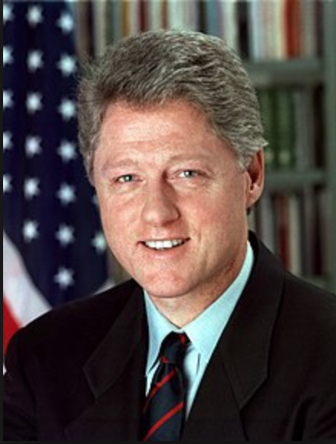
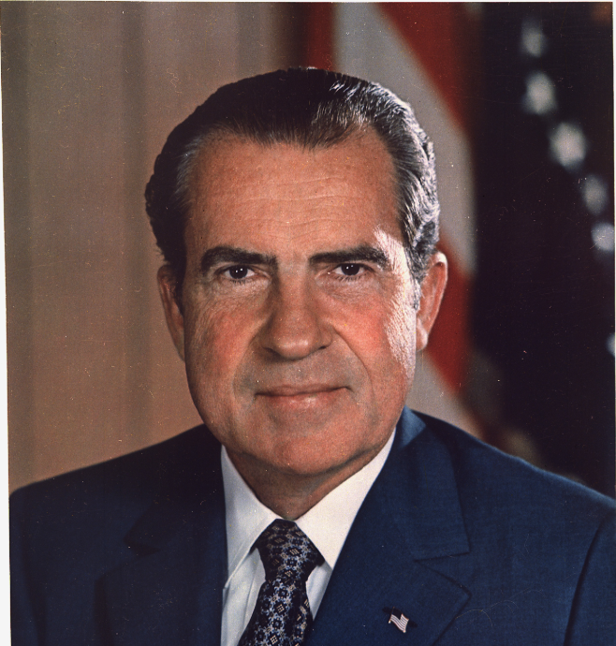
Group 7 The power of Speech
Joachim, Weronika, Gergö, Emil

Slide 2
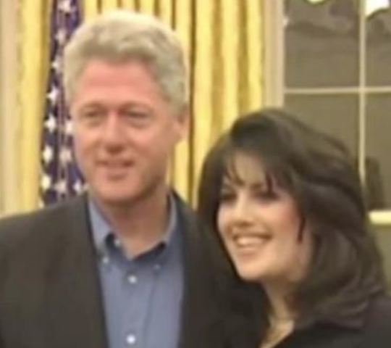
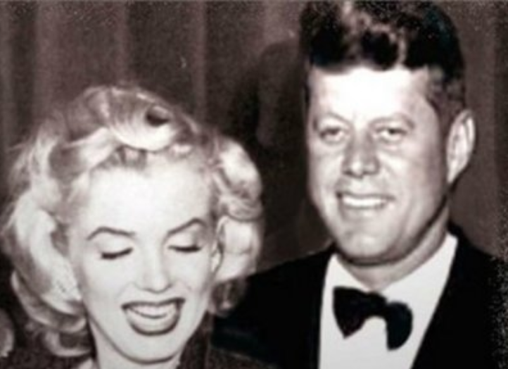
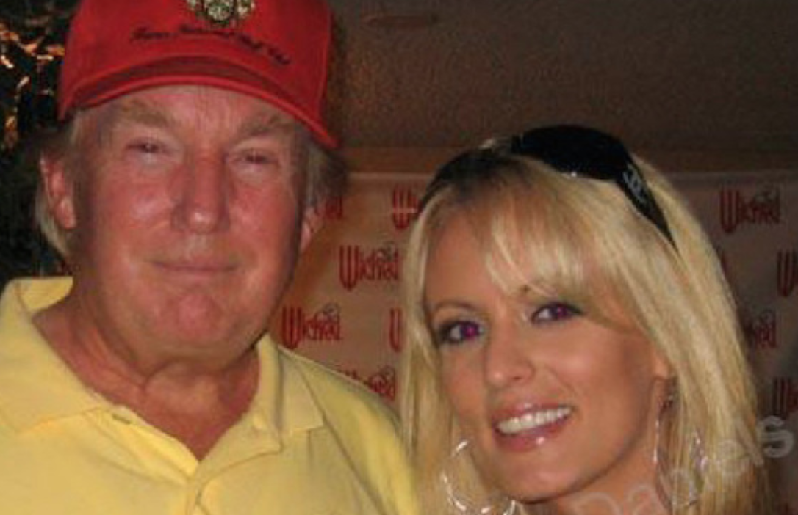
Republican or democrat?
Problem: “In which ways do democratic and republican presidents’ speeches differ?”
Sub question 1: “Does the LIX index increase/decrease over time?”
Sub question 2: “Can we classify cheaters?”
Categories:
- Party (Democrat or republican?)
- Cheater/non-cheater (Cheated or not? Approx 20 did. That’s 44%!)
- Spatial differences (Home state, education)
- War/not war (historical eras)
EDA:
- Transition from speech to entertainment
-
Expected results:
- Finding more patriotic phrasing in republican speeches
- Context matters and impacts findings
- Cheaters will have more off-context speeches (Apologize speeches)

Slide 3
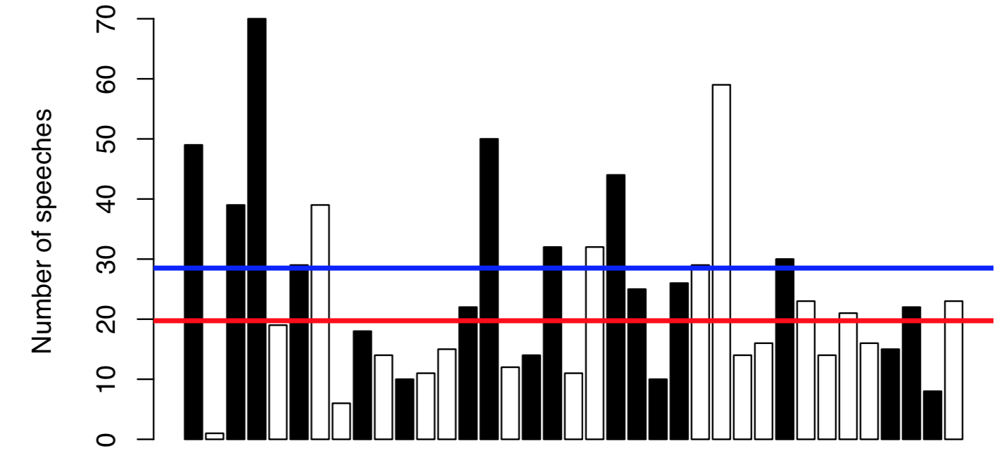
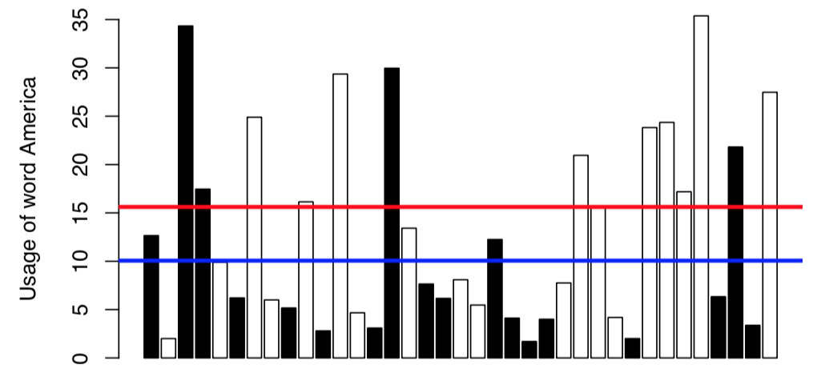
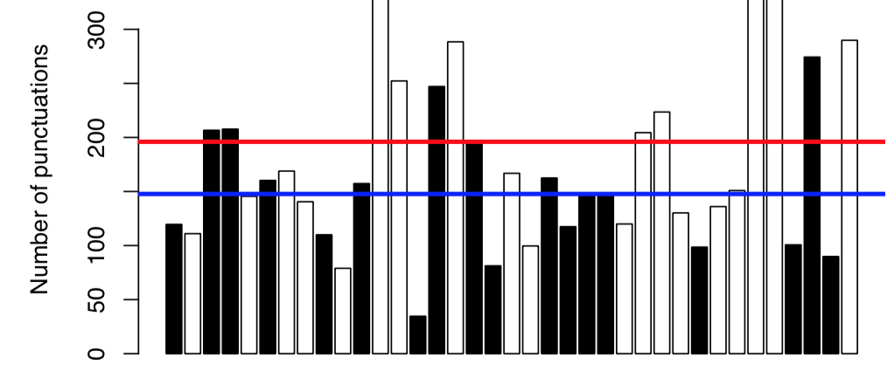
The data

Slide 4
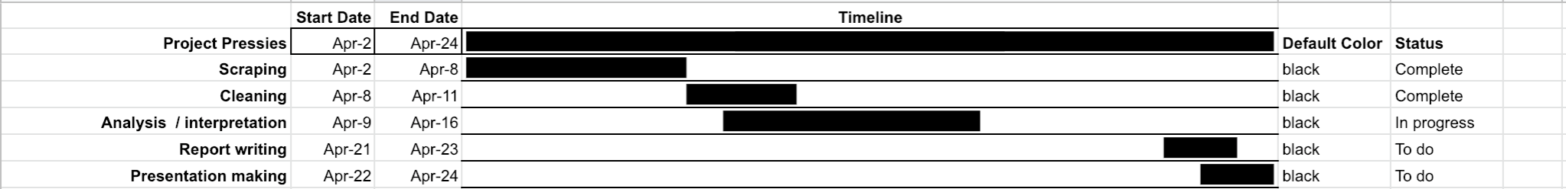
Progress.

